Slide 1
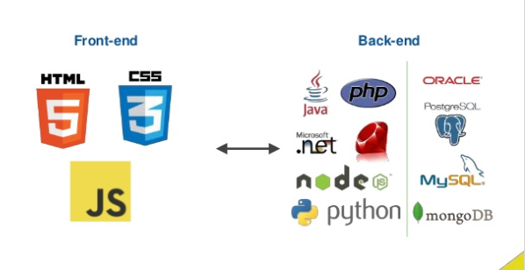
IT 353 Web Development Technologies
Classroom: Office Hours: Tuesday 6:15-7:15pm on Zoom or by appointment
Jianwei Lai
jlai12@ilstu.edu

Slide 2

Where to Find Class Info
Reggienet
Syllabus
Schedule will be posted with updates throughout the semester
Weekly lectures
Some announcements will be posted in Reggienet
Some quizzes/homework in Reggienet
In-Class
Some handouts and announcements given in class
Some quizzes/homework in class

Slide 3
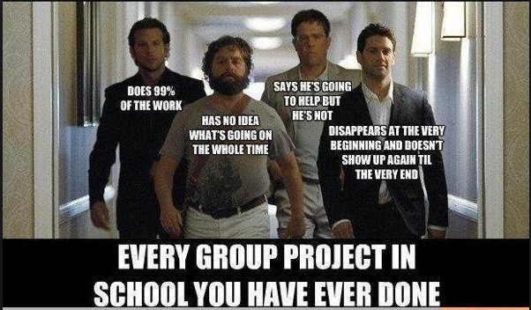
Class Organization
You will have both independent work and the opportunity to work in teams
Not in my class!!!

Slide 4
World Wide Web

Slide 5
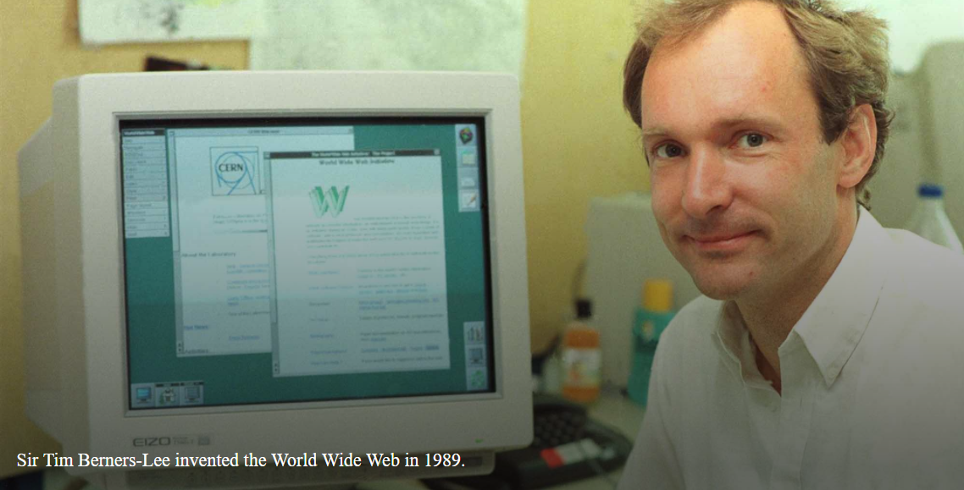
https://webfoundation.org/about/vision/history-of-the-web/

Slide 6
“In those days, there was different information on different computers, but you had to log on to different computers to get at it. Also, sometimes you had to learn a different program on each computer. Often it was just easier to go and ask people when they were having coffee…”, Tim says.
https://www.w3.org/People/Berners-Lee/Kids.html
https://webfoundation.org/about/vision/history-of-the-web/

Slide 7
Tim Berners-Lee's Proposal
In March 1989, Tim laid out his vision for what would become the web in a document called “Information Management: A Proposal”
Believe it or not, Tim’s initial proposal was not immediately accepted.

Slide 8
Three Fundamental Technologies
By October of 1990, Tim had written the three fundamental technologies that remain the foundation of today’s web (and which you may have seen appear on parts of your web browser):
HTML: HyperText Markup Language
URI: Uniform Resource Identifier. A kind of “address” that is unique and used to identify to each resource on the web. It is also commonly called a URL(Uniform Resource Locater).
HTTP: Hypertext Transfer Protocol. Allows for the retrieval of linked resources from across the web.

Slide 9
Syllabus

Slide 10

I’m stopping here to be nice on the first day

Slide 11
Before Next Class
Read the HTML Tutorial on w3schools
https://www.w3schools.com/html/default.asp

